Slide 1
Cirrhotic patient for Emergent Obstructed Inguinal hernia repair
Dr. Madhusudhan Upadhya & Dr. Lakshmi Kumar

Slide 2
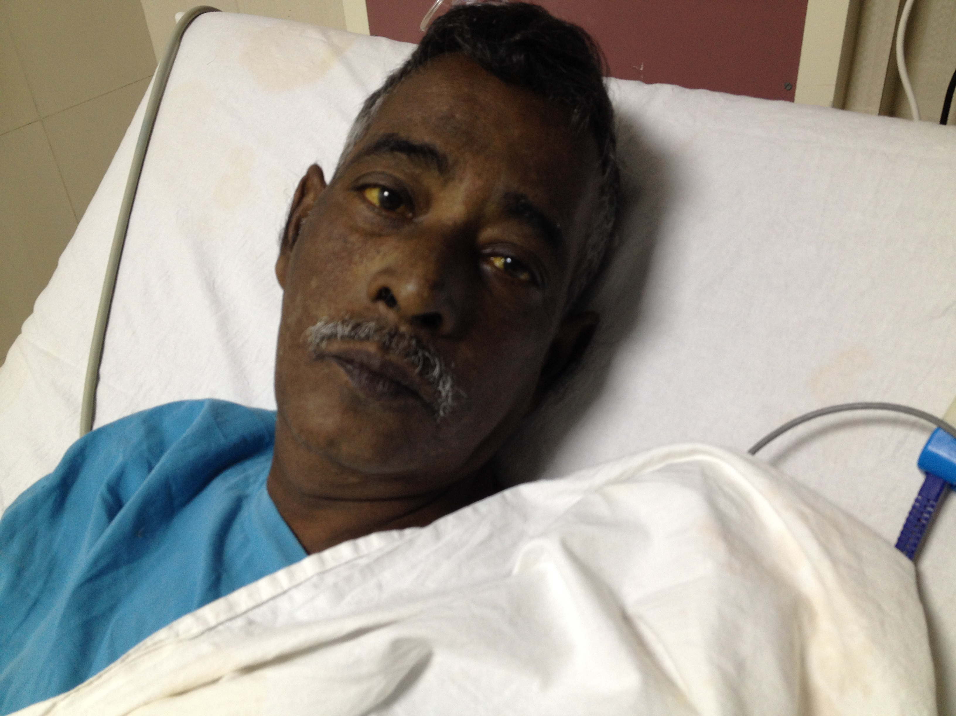
Case Description
A 54 year old male habituated to alcohol for the last 15 years presents to the hospital emergency with lower abdominal pain and irreducible swelling in the inguinal region since 2 days.
On examination he is conscious, oriented, afebrile, mildly icteric, has bilateral pedal edema, mild ascites and wasting of upper trunk. He has been told about his liver disease 5 years ago during routine health check

Slide 3
Q 1:What is cirrhosis?

Slide 4
Q 2: How do we grade and classify Cirrhosis

Slide 5
Child-Turcotte Pugh

Slide 6
CTP & morbidity
CTP class A -10%
CTP class B - 30%
CTP class C - 76% mortality after surgery
Complications & morbidity can vary from 10 – 30%

Slide 7
MELD improvement, objective, includes creatinine

Slide 8
MELD Scoring

Slide 9
MELD Implications
Initially used to predict mortality after TIPS.
Used by UNOS for organ listing.
< 8 can undergo elective surgery
For ever increase above 8, there is a 14% increase in mortality.
> 15 elective surgery not recommended.

Slide 10
Q 3:Pathophysiology of alcoholic cirrhosis

Slide 11
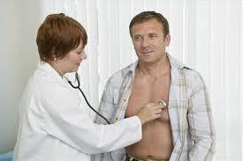
Very common !

Slide 12
Alcoholic Hepatitis

Slide 13
Manifestations
Steatosis : resolves on abstinence from alcohol.
Enzymes may be elevated.
Alcoholic hepatitis: jaundice and fever. Occurs several years after intake of alcohol.

Slide 14
Alcohol & hepatocyte Injury

Slide 15
HPE in alcoholic hepatitis

Slide 16
Its not alcohol…..

Slide 17
Q 4:Coagulation abnormalities in cirrhosis

Slide 18
What is new about coagulation in liver disease?
Coagulopathic?
Parallel balance between
procoagulant
and anticoagulant
Delicate balance ..tips towards
Bleeding or thrombosis.

Slide 19
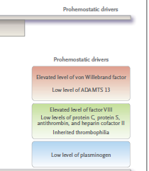
The balance in liver disease

Slide 20
Q 5:Cirrhotic presenting with irreducible /obstructed hernia for repair? Anesthetic concerns

Slide 21
Anesthetic concerns
Emergency: Obstruction full stomach.
Grading of cirrhosis: Multisystemic manifestations
Viability of bowel and extent of surgery
Coagulopathy

Slide 22
Q 6:What are the electrolyte abnormalities in cirrhosis? Why do they occur?

Slide 23
Electrolyte abnormalities
Hyponatremia most common. ECF volume increases, treatment is by fluid restriction. Tolvaptan for resistant cases.
Hyperkalemia/ hypokalemia
Hypomagnesemia
Hypophosphatemia

Slide 24
Q 7:Describe cardiovascular and respiratory changes in cirrhosis?

Slide 25
Cardiovascular
Decrease SVR, increased circulatory volume
Hyperdynamic circulatory state.
LVOTO obstruction with high rates
Cirrhotic CMP
Decreased chronotropic response
Increase RVSP from volume overload

Slide 26
Respiratory
Restrictive lung defect from ascites.
Pleural effusion
Hepatopulmonary syndrome
Portopulmonary hypertension

Slide 27
Q 8:What are the pros and cons of general versus regional anaesthesia? What would you choose?

Slide 28
Choice between GA and RA
Choice depends upon the extent of liver disease
Regional can be an option for Child A and some cases of Child B
Most Child B and C are unfit for regional anaesthesia
Regional when feasible will avoid the effects of GA on multiple systems.

Slide 29
Question 9
You have administered GA and secured the airway.
The surgeon finds a small segment of gangrenous bowel that he decides to resect and complete anastomosis.
You notice that there is a gradual decrease in BP and that the urine output is steadily falling.
What are your concerns and how should you treat?

Slide 30
Hypotension and Oligura
Hepatorenal Syndrome
Splanchnic vasodilatation and renal ischemia
Treated with albumin and terlipressin ‘

Slide 31
Pathogenesis of HRS

Slide 32
Q 10:What is the inhalational agent of choice? Why? What is HABR?

Slide 33
Inhalational agent
Desflurane, Sevo flurane and Isoflurane caiprocal n be used in decreasing order of safety.
Recent reports suggest a decrease in dose for des and isoflurane in liver patients.
HABR: Semireciprocal relationship of blood flow between the hepatic artery and the portal vein mediated by adenosine

Slide 34
Q 11: What are the optimal choices of induction agent and narcotic in a cirrhotic patient?

Slide 35
Induction Agent
Propofol is an ideal agent with short duration and minimal redistribution.
Fall in MAP can reduce the hepatic blood flow.
Fentanyl and remifentanyl

Slide 36
Hypotension & Ischemic Hepatitis

Slide 37
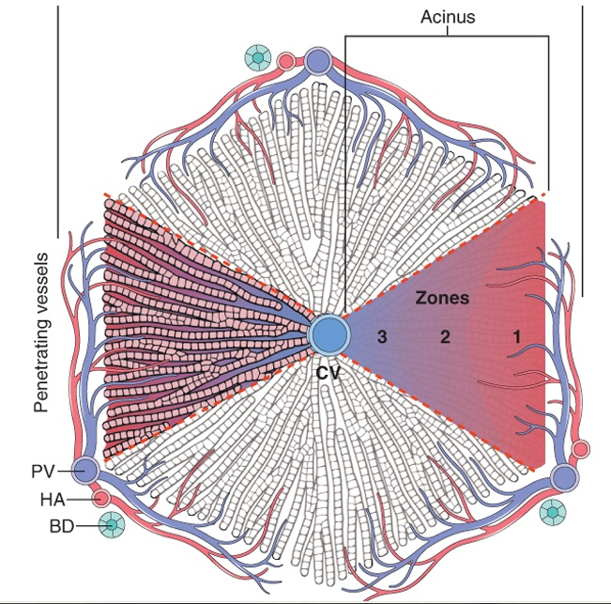
ZONALITY(zonal relationship ) IN LIVER LOBULE
Liver lobule
3 zones of hepatocytes based on Concentration gradients of oxygen and solutes occur along the sinusoidal spaces.
Portal triad
ZONES
I
II
III
Central vein

Slide 38
Q 12: What is the most appropriate IV fluid to be used?

Slide 39
Types of Fluids

Slide 40
A

Slide 41
Q 13:What are the indications for albumin in a patient with cirrhosis?

Slide 42
Albumin
Large volume paracentesis.
Treatment of hepatorenal syndrome.
Correction of hypovolemia
Surgery.

Slide 43
Q 13:What are the analgesic options in inguinal hernia repair

Slide 44
Anlagesia
Multimodal analgesia, PCM with opiod, local infiltration
III, IH nerve blocks, TAP
ESP blocks, Q uadratus Lumborum
Wound infiltration catheters

Slide 45
What are the postoperative concerns in a cirrhotic?

Slide 46
Problems
Delayed recoveryfrom anaesthesia.
Hepatic encephalopathy
Bleeding
MODS

Slide 47
Modified Parson’s-Smith scale of HE
Stage | Clinical Features | Neurological signs | GCS
O / sub clinical | Normal | Only seen on neuro psychiatry testing | 15
1 | Trivial lack of awareness, shortened attention span | Tremor, apraxia, in cordination | 15
2 | Lethargy, disorientation & personality changes | Asterixis, ataxia, dysarthria. | 11-14
3 | Confusion, somnolence to semi stupor, responsive to stimuli | Asterixis, ataxia | 8-10
4 | Coma | Decerebration | < 8
47

Slide 48
Mechanisms of hepatic encephalopathy
Ammonia detoxification does not occur.
Role of inhibitory neurotransmission through GABA
Hypotension by affecting autoregulation of cerebral blood flow.
Hypoxia & release of inflammatory cytokines from necrotic hepatic tissue
Sedatives, hypokalemia & hyponatremia can ppt encephalopathy

Slide 49
Paracetamol & Hepatotoxicity
The maximum safe dose of paracetamol for an adult is 4g/24 hours and in children 90mg/kg.
PCM is metabolised to N acetyl parabenzaquinoneimine(NAPQI) by glutathione
Ethanol abuse, malnutrition, drugs which induce cytochrome oxidase enhance toxicity

